Slide 1
McDonald’s Financial Performance Dashboard (2005–2024)
- Prepared By
Harshini P

Slide 2
Dashboard Objective
Analyze McDonald’s financial performance over the past 20 years
Visualize key KPIs like Revenue, Earnings, Market Cap, and EPS
Identify trends, patterns, and changes in financial health
Apply corporate branding and data storytelling principles

Slide 3
Dataset Overview
Source: McDonald’s Financial Statements (2005–2024) – Monthly data
Columns used: Revenue, Earnings, EPS, Market Cap, Net Assets, etc.
Granularity: Yearly aggregation
Tool used: Power BI

Slide 4
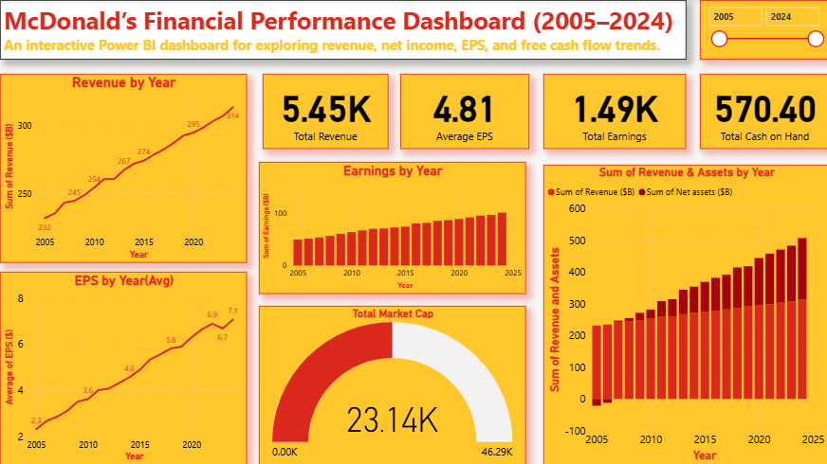
Dashboard Layout & KPIs
Top KPIs: Total Revenue, Average EPS, Total Earnings, Total Cash on Hand
Visuals used:
Line Charts for trend analysis
Bar & Column Charts for comparisons
Donut Chart for Market Cap snapshot
Cards for quick KPIs

Slide 5
Revenue Growth Over Time
Line chart shows a steady growth in revenue from 2005 to 2024
Major jumps in years like [2019]
Insight: Indicates consistent sales growth and business expansion

Slide 6
Profitability Metrics
Bar chart: Net earnings by year shows upward trend
Line chart: EPS increased steadily with a few dips
Insight: Strong profitability, increasing shareholder value

Slide 7
Market Capitalization Snapshot
Gauge chart: Market Cap at $23.14K (in $B)
Compared to max potential of $46.29K
Insight: Strong investor confidence and stable market value

Slide 8
Revenue vs Net Assets Comparison
Line and stacked column chart showing Revenue and Net Assets by year
Both metrics rise consistently → strong financial management
Insight: Company is expanding while maintaining asset strength

Slide 9
McDonald’s Branding Applied
Used official brand colors: Red #DA291C, Yellow #FFC72C, Black
Consistent design across visuals
Easy-to-read typography and KPI highlighting

Slide 10
Key Takeaways
McDonald’s shows consistent growth in revenue and earnings
EPS growth reflects shareholder value creation
Strong market cap indicates investor confidence
Balanced financial health: assets and earnings are growing in parallel

Slide 11
Conclusion
Dashboard provides a 360° view of McDonald’s financial performance
Helps stakeholders make data-driven decisions
Can be extended with additional KPIs (e.g., Operating Margin, Debt Trends)

Slide 12
THANK YOU

